Slide 1
Applied Deep Learning Project (WS2025)
IMDB Sentiment Analysis Using NLP
Name: Aman Bhardwaj
Student ID: 12333472
Introduction
In this project, I re-implemented a deep learning-based system to classify movie reviews from the IMDB dataset as positive or negative. Using a RoBERTa transformer model, I implemented an end-to-end pipeline from data preprocessing to model training, evaluation, and deployment in a web-based Streamlit application.
Approach: Bring Your Own Method – Re-implemented and fine tuned the model
Dataset: IMDB Large Movie Reviews – 50,000 labeled reviews (binary sentiment).
Model: RoBERTa-base Transformer for contextual text understanding.
Tokenizer: RoBERTa Byte-Pair Encoding (BPE).
Loss Function: Cross-Entropy Loss for binary classification.
Deliverables: Pipeline + interactive Streamlit web app for real-time sentiment prediction.

Slide 2
Data Preprocessing
The IMDB reviews were preprocessed minimally and tokenized to feed into a RoBERTa transformer model, which excels at understanding contextual language. The RoBERTa tokenizer converts text into sub-word tokens, while the model is trained using Cross-Entropy Loss for binary sentiment classification.
Dataset Split: 80% Train / 10% Validation / 10% Test
Minimal Text Cleaning: Removed HTML tags and normalized whitespaces; no lowercasing or stopwords,
as RoBERTa is pretrained on raw text. Saved cleaned CSVs
RoBERTa Model:
  Pretrained transformer encoder for contextual language understanding
  Fine-tuned for sentiment classification with 2 output classes (Positive / Negative)
Tokenizer:
  Byte-Pair Encoding (BPE)
  Converts text → Input IDs & Attention Masks
  Max sequence length = 256
Saved .pt files for train/val/test

Slide 3
Model Training & Optimization
After preprocessing and tokenization, the RoBERTa model was trained on the IMDB dataset. We implemented both a baseline and an optimized fine-tuned model, experimenting with hyperparameters like learning rate, batch size, dropout, weight decay, and pooling to maximize performance.
Baseline Model:
Trained only the classification head for 5 epochs
Metrics established a reference performance
Optimized Model:
Fine-tuned all layers of RoBERTa
Hyperparameter tuning across 8 configurations
Early stopping used to prevent overfitting
Hyperparameters Considered:
Learning rate: 1e-5, 2e-5, 3e-5
Batch size: 16, 32
Dropout: 0.1, 0.2
Weight decay: 0, 0.01
Pooling: CLS / Mean
Scheduler: linear / cosine
Tokenized Inputs (.pt files)
│
▼
RoBERTa Classifier
│
▼
Train/Validation → Hyperparameter Tuning
│
▼
Early Stopping → Best Model Selection
│
▼
Test Set Evaluation → Metrics & Plots
Training time: ~16 hours for optimized configurations

Slide 4
Results Table (Best Model)
Metric | Train | Validation | Test
Accuracy | 0.9862 | 0.9429 | 0.9430
Precision | 0.9850 | 0.9431 | 0.9355
Recall | 0.9875 | 0.9427 | 0.9516
F1-score | 0.9862 | 0.9429 | 0.9435
Loss (CE) | 0.0209 | 0.2864 | 0.2727
Runtime (s) | 5722.76 | 5722.76 | 197.21
Best configuration after training: { "lr": 1e-05, "batch_size": 32, "dropout": 0.1, "weight_decay": 0.0, "scheduler": "cosine", "warmup_ratio": 0.06, "pooling": "cls" }
The validation set showed a bit less performance than the training set which is understandable as the size of the validation set is 8 times smaller than training set. Below are the plots for the training of the model, validation confusion matrix and runtimes:

Slide 5
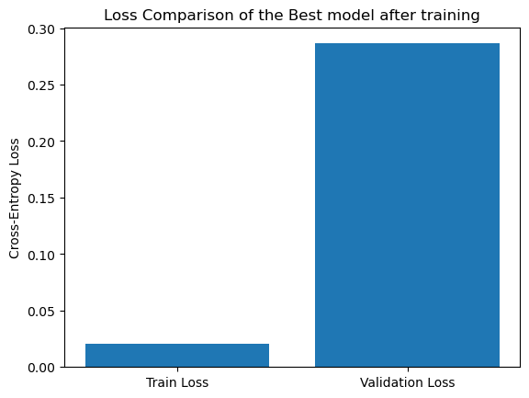
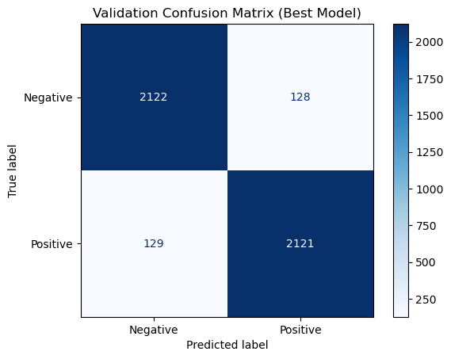
Test Results (Best Model)
Split | Accuracy | Precision | Recall | F1-score | Error | Loss | Runtime (s)
Test | 0.9430 | 0.9355 | 0.9516 | 0.9435 | 0.0570 | 0.2727 | 197.21
So, from the above tables it can be seen that the F1 score improved a bit for the test set and Cross Entropy Loss also improved a little.. Below are the plots for the testing of model:

Slide 6
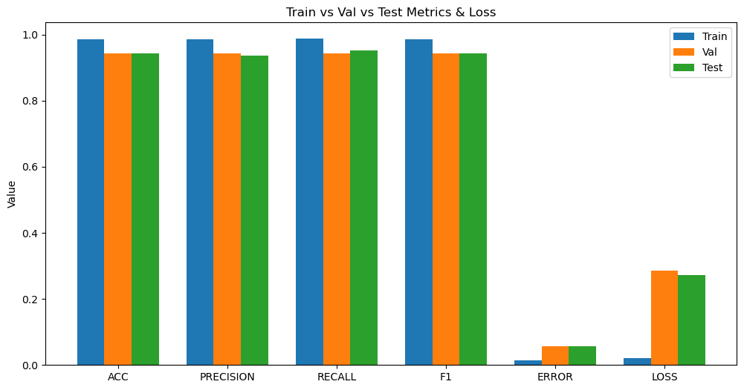
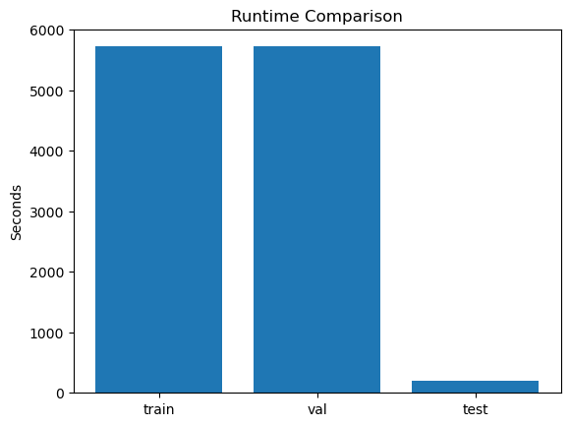
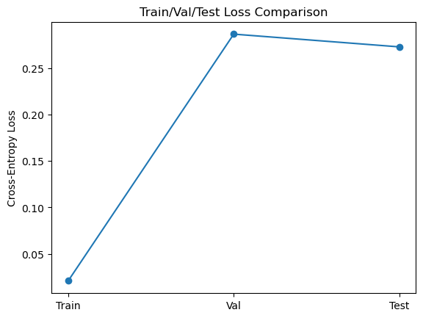

Slide 7
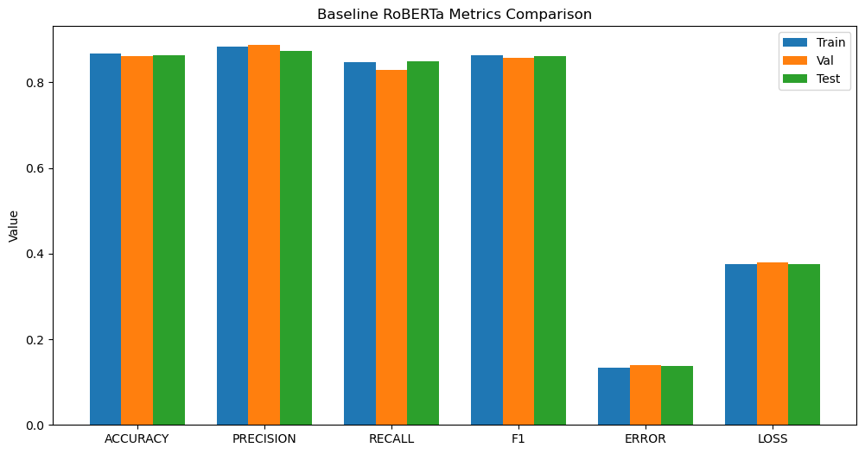
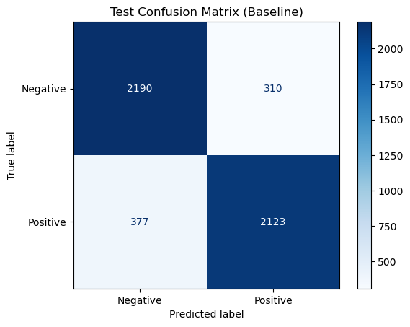
Baseline Model
RoBERTa with linear classification head. Trained head only for 5 epochs with Default hyperparameters
Baseline Results Table:
Split | Accuracy | F1-score | Loss | Runtime (s)
Train | 0.8667 | 0.8639 | 0.3757 | 492.02
Val | 0.8611 | 0.8564 | 0.3786 | 54.66
Test | 0.8626 | 0.8607 | 0.3762 | 60.74

Slide 8
Comparison: Optimized vs Baseline
Metric | Optimized (Fine-Tuned) | Baseline RoBERTa
Accuracy | 0.9435 | 0.8626
Precision | 0.9355 | 0.8726
Recall | 0.9516 | 0.8492
F1-score | 0.9435 | 0.8607
Error | 0.0570 | 0.1374
Loss | 0.2727 | 0.3762
Runtime (s) | 197.21 | 60.74
So, from the above table it can be clearly seen that my reimplemented and fine Tuned RoBERTa model performed quite better than the SOTA baseline RoBERTa model. The cross-entropy loss for optimized model is very less as compared to the base model. The Primary metric for comparison I took was F1 score and Optimized model has higher F1 score as compared to the baseline model. So, the optimized model significantly outperforms the baseline across all metrics. Fine-tuning all layers and hyperparameter tuning led to higher F1-score (0.9435 vs ~0.8607).

Slide 9
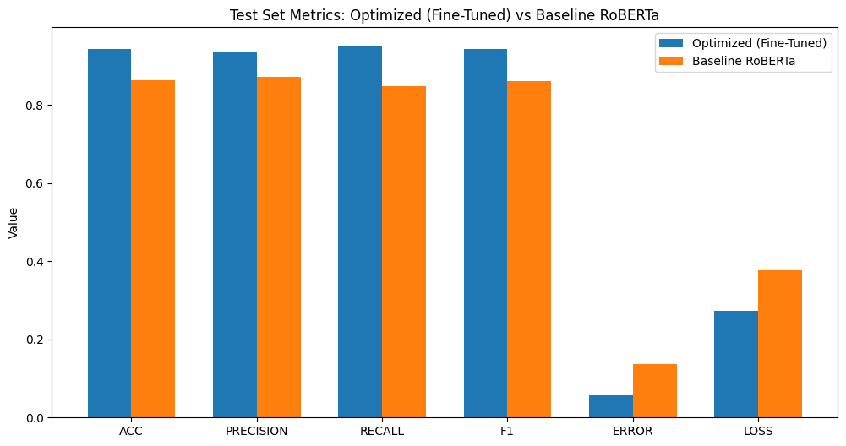
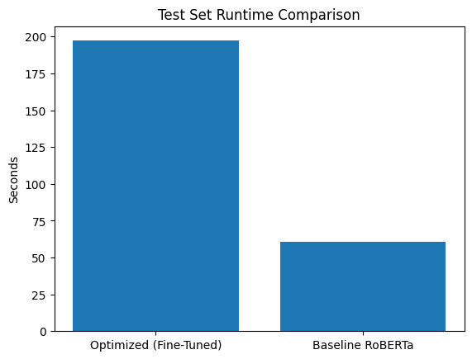
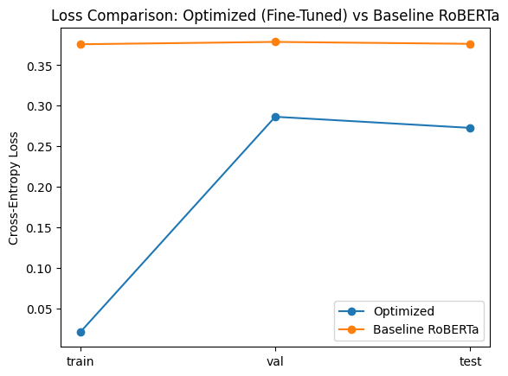

Slide 10
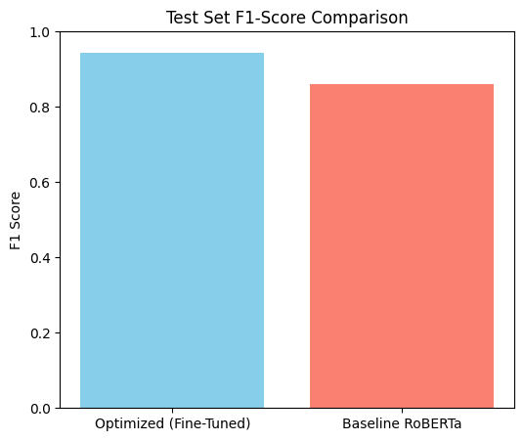
The above plot shows that the F1 score of the Optimized model is significantly higher and thus shows better performance than the base model.

Slide 11
Deployed Model and Inference Setup
Web Application Implementation (Streamlit-Based Deployment)
The sentiment analysis system is deployed as a Streamlit web application, offering:
Text input for user reviews
Real-time prediction
Confidence score display
Decision strength visualization
Warning messages for ambiguous sentiment
The deployed pipeline follows these steps:
User enters a movie review in the web interface
2. Text is tokenized using the RoBERTa tokenizer
3. Tokenized inputs are passed through the fine-tuned model
4. Model outputs raw logits for positive and negative sentiment
5. Temperature scaling is applied to logits
6. Final prediction, confidence score, and decision strength are displayed on the web app

Slide 12
Conclusion
This project demonstrates a complete end-to-end deep learning workflow: from dataset selection and preprocessing to model training, optimization, evaluation, deployment, and reflection. The fine-tuned RoBERTa model achieved strong performance on the IMDB dataset and was successfully transformed into a usable web application.
The project highlights both the strengths and limitations of deep learning for sentiment analysis and provides practical insights into real-world NLP system design.

